Slide 1
2.INDUSTRIAL SAFETY 3.OCCUPATIONAL HEALTH AND SAFETY
BSS –DIPLOMA & Adv. Diploma

Slide 2
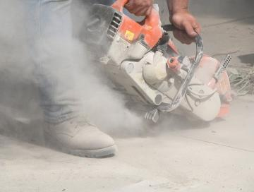
Forms of, Classification of and Health Risks from Hazardous Substances
Physical Forms of Chemicals
The physical form greatly affects the hazard presented and the route of entry into the body
Solids (Lead ingot)
Liquids (Solvents)
Gases (Co)
Vapour (toluene)
Mists and aerosols (deodorant)
Smoke (coal burning)
Fumes (welding)
Dusts (Pharma dust)

Slide 3
Substances can occur in many physical forms. Knowledge of the physical form is essential in determining appropriate control methods, particularly in the use of respiratory protection.
Definitions of the forms of chemical agents (dusts, fumes, gases, mists, vapors and liquids) are as follows:
Dust: Airborne solid particles (an aerosol) that ranges in size from 0.1 to 50 mm and larger in diameter. Dusts are generated and dispersed into the air by, for example, handling, sieving, crushing and grinding of organic or inorganic materials such as rock, ore, metal, coal, wood and grain.
In still atmospheres, dust can tend to settle under gravity, and where dust accumulations are produced a serious hazard in regard to a dust explosion, can occur.
Toxic dusts may, in the event of constant exposure, cause serious lung damage. General poisoning can result from the inhalation of toxic dusts, e.g. asbestos.

Slide 4
Fume: An aerosol of solid particles generated by condensation from the gaseous state, generally after a metal has been converted from molten metals.
The solid particles that make up a fume are extremely fine, usually less than 1.0 mm in diameter.
In most cases, the volatized solid reacts with oxygen in the air to form an oxide, these produce highly toxic fumes. Common examples include cadmium oxide fume, welding and lead burning.
Lead, cadmium, zinc, copper and magnesium are particularly hazardous and inhalation of their fumes can give rise to an illness known as "metal fume fever". Complete removal from the exposure will see full recovery within a matter of days.

Slide 5
Gas: A formless fluid that completely occupies the space of any enclosure at the right temperature and pressure.
There are many toxic gases used in industry, such as chlorine, sulphureted hydrogen (hydrogen sulfide, H2S) etc.
Many are nasal and respiratory tract irritants. This irritant factor can give rise to immediate evacuation (for example, sneezing) before too much harm is done to the tissues lining the respiratory passages.
Liquids, particulates, gases and various aerosols are all physical states which are liable to create hazards in terms of corrosion, toxicity, fire and explosion.

Slide 6
Mist: An aerosol of suspended liquid droplets generated by condensation from the gaseous to the liquid state or by the breaking up of a liquid into a dispersed state, such as by splashing, foaming, or atomizing.
Mist is formed when a finely divided liquid is suspended in the atmosphere.
Examples are the oil mist produced during cutting and grinding operations, acid mists such as chromium from electroplating, acid or alkali mists from pickling operations, and paint spray mist from spraying procedures.

Slide 7
Vapour: The gaseous phase of a material that is liquid or solid when there is a rise in temperature which causes the vapourization. Examples are organic solvent vapours.
Mercury is a particularly hazardous chemical; it can vaporize at room temperature and create a toxic atmosphere.
Liquids: It has been estimated that two-thirds of all industrial injuries from chemicals are skin injuries caused by direct bodily contact with liquid acids and alkalis due to the corrosive effect of these substances.

Slide 8
Aerosol: A dispersion of particles of microscopic size in a gaseous medium; may be solid particles (dust, fume, smoke) or liquid particles (mist, fog).
Smoke: An aerosol of carbon or soot particles less than 0.1 mm in diameter that results from the incomplete combustion of carbonaceous materials such as coal or oil. Smoke generally contains droplets as well as dry particles.

Slide 9
Fog: A visible aerosol of a liquid, formed by condensation.
The hazard of airborne particulate matter in the workplace has historically been one of the greatest challenges facing occupational safety and health practitioners.
Exposure to particulates is a problem in a bewildering array of industries, processes and occupations, which may encompass mining, quarrying, building & construction work, chemical or textile processing, foundry working, welding, spray-painting or crop-dusting, to name but a few.

Slide 10
The health effects caused by particulate exposure are equally diverse. Skin contact with some dusts, such as organic dusts from flour and grains, may cause irritation or allergic responses in sensitised persons, while inhalation of other organic dusts, particularly some wood dusts, has been shown to cause nasal cancer in heavily exposed workers.
However, the major health effects are usually found in the lungs, where particulate matter may penetrate deep down to the gas exchange region (the alveoli) and cause severe fibrotic reactions. An example of this is silicosis, which results from exposure to silica.

Slide 11
Other lung reactions include bronchitis, which is over-production of mucous associated with inflammation of the bronchi; asthma which is a constriction of the bronchial tubes; and cancer. Restricted lung function can place burden on the right side of the heart and this additional strain can result in irreversible heart damage over time.

Slide 12


Hazards and hazard management
Irritant:
Inflammation on contact with skin, eyes or tissue may cause inflammation e.g. adhesives and detergents
Corrosive:
Destroys living tissue at point of contact (skin) strong acids or alkalis i.e. H2SO4 (Sulphuric Acid), Caustic, ammonia

Slide 13

Hazards and hazard management
Harmful: Larger doses cause death or serious illness
e.g. Trichloroethylene
Toxic: Small doses cause death or serious illness
e.g. cyanide

Slide 14
Hazards and hazard management
Carcinogenic:
Substances which cause disorders in cell growth that may lead to cancer or increase its incidence e.g. Benzene

Slide 15
Acute and Chronic Health Effects
Acute
High levels of exposure
Short exposure time
Quick effect
e.g. high concentration of chlorine gas
Chronic
Lower levels of exposure
Longer exposure time
Long term effect
e.g. repeated exposure to solvents

Slide 16
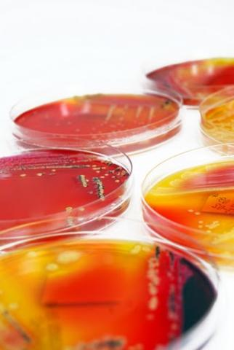
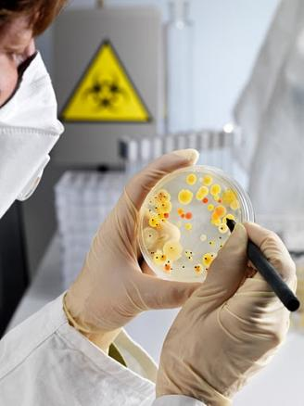
Biological Agents
Fungi
e.g. Farmer’s lung
Bacteria
e.g. legionnaire’s disease, Leptospira Bacteria
Viruses
e.g. HIV, Hepatitis B

Slide 17
Hazards and hazard management
Biological Hazards Control Measures
Cleaning / Disinfecting
Water treatment programmes
Vermin control A pest animal prohibited, controlled
Procedures for handling, containment & disposal
Personal hygiene
Immunisation to build resistance to specific infections
Health surveillance strategies and methods to detect and assess systematically the adverse effects of work on the health of workers.
Specific training
PPE

Slide 18

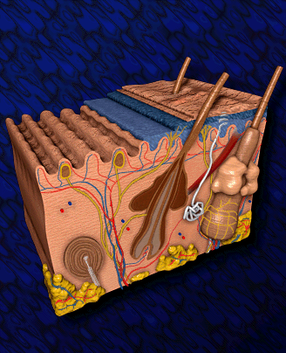
TOXICOLOGY - Routes of Entry
Inhalation
Ingestion
Absorption
Injection (Direct Entry)

Slide 19
TOXICOLOGY - Routes of Entry
Inhalation
most important route of entry
substances can directly attack lung tissue
responsible for 90% of all cases of industrial poisoning
Ingestion
via the mouth
often accidental
poor hygiene
Absorption
through the skin
solvents may penetrate unbroken skin
Injection
when skin is damaged
puncture of the skin
contact with liquid or gas under pressure

Slide 20
Hazards and hazard management
AIRBORNE DUST
Respirable dust:
Airborne dust of such a size about 0.5 microns that it is able to enter the lungs during normal breathing
Respiratory diseases:
Asbestosis
Silicosis
Asthma
Bronchitis
Lung Cancer
Farmer’s lung

Slide 21
Assessing levels of dust
Visual examination
Sampling for dust
Personal samplers
Fixed samplers
Sample for a fixed time
Dust lamps
Dust accumulation

Slide 22
Control Measures to Reduce Exposure to Dust
Eliminate at source
Substitute with pellets
Change process
Use liquid process
Enclose the complete process
Ventilation
Control by suppression
Housekeeping
Maintenance

Slide 23
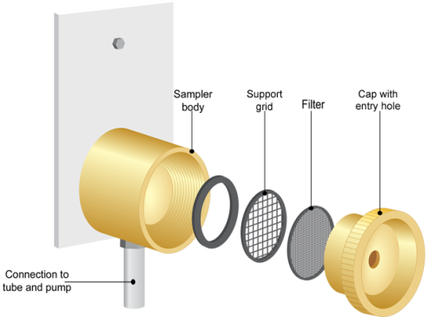
Dust Monitoring Equipment
Worn by worker whilst working
Indicates personal exposure
Pre-weighed filter
Pumped air
Filter re-weighed
Gives average value over time

Slide 24
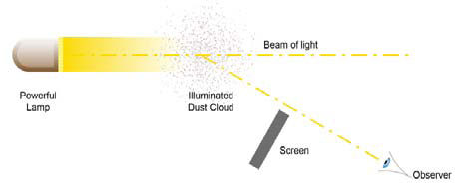
Dust Lamp (Tyndall Lamp)
Strong beam of light
Highlights fine particles of dust
Used to determine efficiency of exhaust ventilation

Slide 25
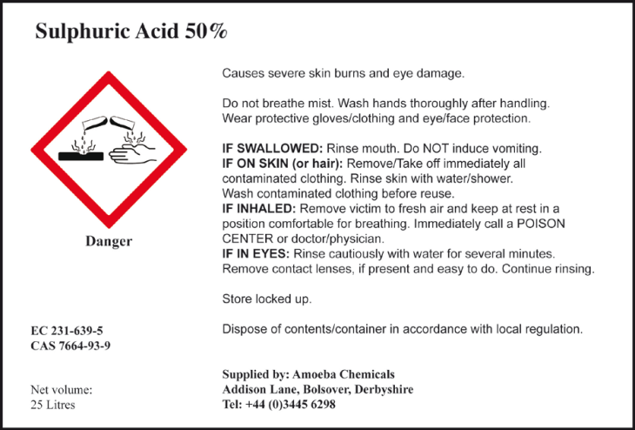
Sources of Information
Product Labels
Name of substance
Hazardous components
Risk phrases indicating danger
Precautions
Details of supplier

Slide 26
Workplace Exposure Limits
The maximum concentration of an airborne substance averaged over a reference period, to which employees may be exposed by inhalation.”
Legal status in national law
 | Time period | Combat ill-health effects of:
Short term exposure limits (STEL) | 15 minutes | Acute effects Very high exposure for a short time
Long term exposure limits (LTEL) | 8 hours | Chronic effects Lower exposure over longer period

Slide 27
International Variations
UK
Workplace Exposure Limits (WEL’s)
Published by HSE, full legal status
USA
Threshold Limit Values (TLV’s)
Published by American Conference of Government Industrial Hygienists
Guidelines, no legal status
No global standard as yet
EU Indicative limit values

Slide 28
Common Methods of Control
Elimination or substitution
Process change
Reduce exposure times
Enclosure or segregation
Local Exhaust Ventilation
PPE
Personal hygiene and protection
Health Surveillance/monitoring

Slide 29
Elimination and Substitution
Eliminate process, - Remove the Hazard
e.g. outsource painting
Substitute – Reduce the hazard,
e.g. High Solvent Paint to Low solvent Paint
irritant to non-hazardous floor cleaner, or corrosive to irritant

Slide 30
Change the Process
Do the job differently
E.g. applying solvent by brush rather than spraying
Vacuuming rather than sweeping to keep dust levels down
Reduce Exposure Times
Job rotation
Exclude non-essential personnel
Link to WEL’s
Enclosure or Segregation
Enclosure
Totally enclose the substance
Prevent access to it
Segregation
Keep people away
Designated areas

Slide 31
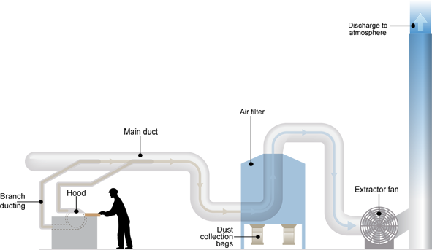
Local Exhaust Ventilation

Slide 32
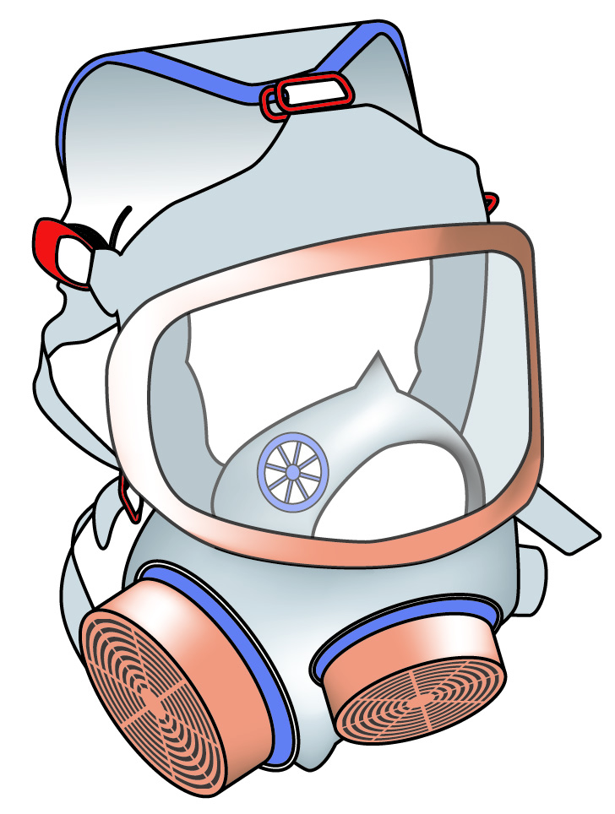
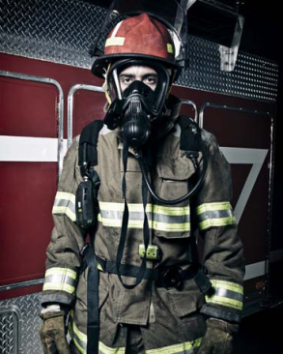
Respiratory Protective Equipment (RPE)
Two types:
Respirators
– filter contaminated air
Breathing apparatus (BA)
oxygen depleted atmospheres
provide clean source of air
Notes:
Here ensure that the students know the difference between respirators and BA, and the fact that respirators can’t be used in an environment where there may be oxygen deficiency, or where the contaminant is very toxic. The respirator can only remove contaminant, it can’t add oxygen. Also the respirator by suffer “break through” and allow contaminants into the breathing air of the user. There is no indicator to warn that the filters are saturated.

Slide 33

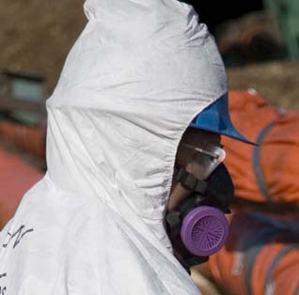
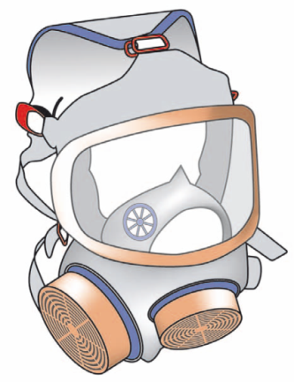
Filter Face-piece Respirators
Half Mask or Ori-nasal Respirator
Full Face Respirator

Slide 34
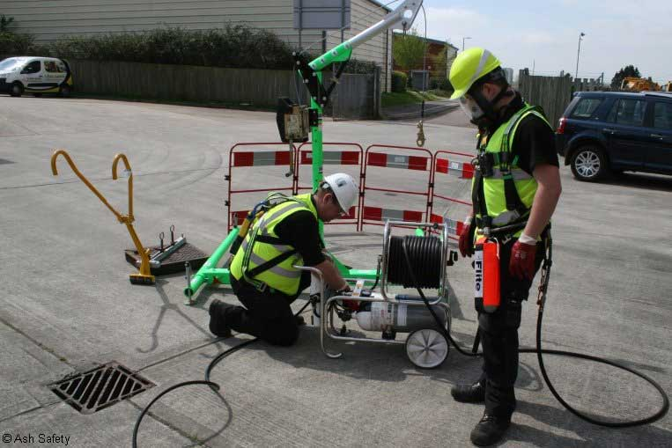
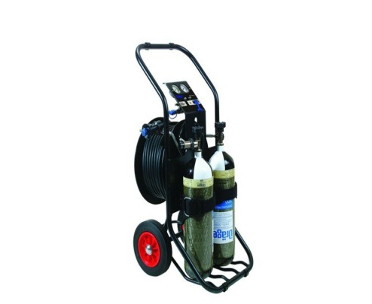
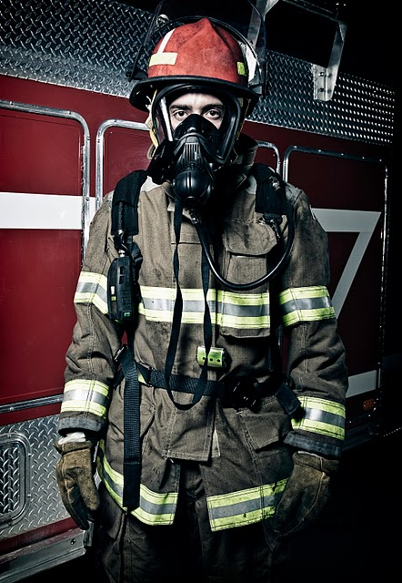
Fresh Air Hose BA
Air demanded by user
Pumped
Air under pressure
Pressurised cylinder
Compressed Air BA
Self-contained BA

Slide 35
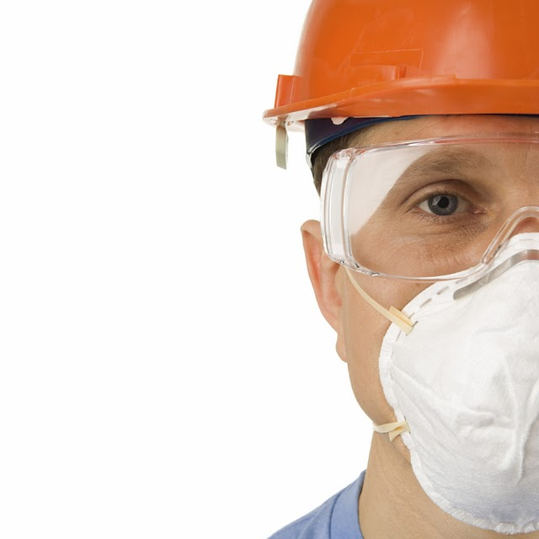
The Suitability of RPE
Factors to consider:
Concentration of the contaminant and its hazards
Physical form of the substance
Level of protection offered by the RPE
Presence or absence of oxygen
Duration of time that it must be worn
Compatibility with other items of PPE
Shape of the user’s face
Facial hair
Physical requirements of the job
Physical fitness of the wearer
Notes:
Discuss here the concept of the APF

Slide 36
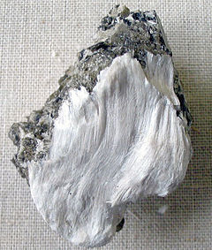

Specific Agents
Asbestos
Naturally occurring mineral fibres used for fire-resistant building and lagging materials
Diseases:
asbestosis
lung cancer
TYPES OF ASBESTOS
Amosite - Brown
Tremolite - Green
Chrysotile - White

Slide 37
Work with Asbestos
In general:
Work must be notified to the enforcement agency
Work area sealed
PPE and RPE
Negative pressure ventilation system with efficient filters
Asbestos waste
securely double bagged
labelled
disposed as hazardous waste
Dust levels monitored inside and outside sealed work area
Worker exposure must not exceed control limit
Health surveillance provided

Slide 38
Carbon Monoxide (CO)
Colourless, odourless gas
By-product of combustion, e.g. poorly maintained boilers
Inhalation hazard
Prevents red blood cells absorbing oxygen
Chemical asphyxiation
Low levels – worsening headaches
High levels – rapid unconsciousness and death

Slide 39
Carbon Monoxide (CO)
Typical controls:
Competent engineers for gas systems
Maintenance and testing of boilers and flues
Good ventilation
LEV for workshop vehicle exhausts
Siting of equipment containing combustion engines
CO alarms
Confined space entry controls

Slide 40
Legionella Bacteria
Legionnaire’s disease
Water-loving soil bacteria
Inhalation hazard
Mists particularly high risk
Flu-like fever, pneumonia
Typical controls:
Enclosing water systems
Water treatment, e.g. chlorination
Hot water >60ºC
Biocides (treatment chemicals)
Prevention of limescale
Routine cleaning of cooling towers
Water sampling and analysis

Slide 41
Leptospira Bacteria
Infected urine from: rats, mice, cattle and horses
Contaminated water in contact with cuts, grazes, etc.
Dairy farmers, sewage workers, water sports instructors
Flu-like symptoms, jaundice, liver damage (Weil’s disease)
Typical controls:
Preventing rat infestation – good housekeeping, pest control
Good personal hygiene
PPE, especially gloves
Covering cuts and grazes
Issuing ‘at risk cards’ to workers

Slide 42
Silica
Component of rock
Quarries, pottery and construction industry
Inhalation hazard
Causes scar tissue to form in lungs
Typical controls:
Alternative work methods
Dust suppression by water
LEV
RPE
Heath surveillance

Slide 43
Hazard communication
Material Safety Data Sheets
(MSDS)

Slide 44
The Law
Ensures all employees’ right to know the
hazards of chemicals they work with at their job
Mandates that employees must be provided
with information about chemicals they work with
through
information on chemical labels
Material Safety Data Sheets (MSDSs)
training on hazard communication
Notes:
“Right to Know Law”- the common language title of the standard (If the audience cannot remember the HazCom standard, then the “Right to Know Law” may be something that they can remember)
This slide presents the common definition of the standard, that all employees have the right to know about the hazards of the chemicals they work with at their jobs

Slide 45
Hazard Communication Rules
Intent - to provide employees with information to help them to make knowledgeable decisions about the chemical hazards in their workplace
Manufacture, Storage And Import of Hazardous Chemicals Rules (MSIHC Rules) 1989
Rule 17. Collection, Development and Disseminations of Information
Schedule 9 (MSDS Format)
Notes:
This slide tells the standard basics:
Where is the standard located within the OSHA standards?
What is the general intent?
What is the standard all about?

Slide 46
Requirements by MSIHC Rules
Written On-Site Emergency Management Plan
Labels to identify each chemical
Material Safety Data Sheets (MSDSs)
Safe work procedures/practices
Information to be given to persons liable to be affected by a accident including Outside premises
Employee training on MSDS information and safe chemical procedures/practices
Notes:
[your company examples here]

Slide 47
Why Is a Standard Necessary?
To evaluate the hazards of all chemicals imported into, produced, or used in workplaces
To prevent or minimize employee exposure to chemicals
Chemical exposure can contribute to serious health effects
heart aliments – kidney/lung damage
sterility – burns/rashes
cancer
central nervous system damage etc.
Notes:
Why is the standard necessary?
KOPPERS examples:
Rational of why the standard is needed

Slide 48
Boiling Point
The temperature at which a substance changes its state from a liquid to a gas at a standard pressure (boils) - measured in degrees Celsius (°C).
Helps determine whether a material is a solid, liquid, or gas at room temperature
Helps determine potential hazard and route of exposure:
Below 100°C: Inhalation Hazard
Above 100°C: Dermal Hazard
Notes:
DISCUSSION POINTS RELATED INSTRUCTOR ACTIVITES
There are 100s of publications that govern the transportation of HAZMAT.
The regulations vary by country, by company or organization, and even by
mode (aka the method by which you ship)
We will focus on the ones that will concern us in the military, Specifically QUESTION: In the Navy, we have the Navy Regs, does anyone
the four publications that you will use for the next two weeks and in the daily know what the federal government calls the compilation of all
functions of your job transporting hazardous materials. the federal rules and regulations that apply in the United States?
The Code of Federal Regulations.
This leads us into the Federal Government’s requirements for the transportation of HAZMAT.

Slide 49


pH Scale
Value used to represent the acidity or alkalinity of a solution
The neutral p^{H} ( 7) is that of water. The p^{H} range of 5.5 to 8.5 is normally acceptable. p^{H} less than 6.5 and more than 8.5 can affect flora, fauna and also people.
Increasing acidity
Increasing alkalinity
0 1 2 3 4 5 6 7 8 9 10 11 12 13 14
Neutral
Never store Acids and Bases together!

Slide 50
Fire and Explosion Data
Flash point ºC (OC) (CC)
-11
Flammability LFL % v
UFL % v
1.4
8.0
TDG Flammability
3
Explosion sensitivity to impact
No
Explosion sensitivity to static electricity
Yes
Autoignition Temperature ºC
580
Combustible Material
Yes
Explosive Material
No
Hazardous Polymerization
No
Flammable Material
Yes
Oxidiser
No
Corrosive Material
No
Pyrophoric Material
No
Organic Peroxide
No
Other information : Highly Flammable
Hazardous Combustion Products
None

Slide 51
Flash Point
LOWEST TEMPERATURE AT WHICH A LIQUID GIVES OFF ENOUGH VAPOR TO FORM A FLAMMABLE MIXTURE WITH THE AIR ABOVE THE LIQUID. (WILL NOT SUSTAIN FLAME)
Flammable vs. Combustible
FP <60.5 degrees C = Flammable
FP 60.5 to 93 degrees C = Combustible
Auto-ignition Temperature
THE MINIMUM TEMPERATURE REQUIRED TO INITIATE SELF-SUSTAINED COMBUSTION OF A SUBSTANCE INDEPENDENT OF EXTERNAL IGNITION SOURCES.

Slide 52

Explosive Limits
Apply generally to vapors and are defined as the concentration range in which a flammable substance can produce a fire or explosion when an ignition source (such as a spark or open flame) is present.
The concentration is generally expressed as percent fuel by volume.
LEL: Lower Explosive Limit
UEL: Upper Explosive Limit
Explosive Material
A chemical that causes a sudden, almost instantaneous release of pressure, gas, and heat when subjected to sudden shock, pressure, or high temperature.

Slide 53
EXPLOSIVE RANGE
If Explosive Range falls below the Lower Explosive Limit (LEL), the mixture of air and vapor is too lean for an explosion
If Explosive Range is above the maximum explosive range or Upper Explosive Limit (UEL), the mixture of vapor and air is too rich to be explosive

Slide 54
100%
TOO RICH FOR COMBUSTION
UEL
COMBUSTIBLE MIXTURE
GAS CONCENTRATION
(MIXTURE IN AIR)
LEL
TOO LEAN FOR COMBUSTION
0%
Upper and Lower Flammability Levels

Slide 55
TDG Flammability / Corrosive material / Hazardous polymerization
TDG Flammability
Transport of Dangerous Goods Flammability and is the same as flammable ( dangerous ) goods in the UN list of dangerous goods
Hazardous polymerization
Polymerization is a highly exothermic reaction, if a martial having tendency to polymerise, starts polymerising the temperature increases which may lead to fire/explosion
Corrosive material:
Quite a few materials are corrosive to steel which is a common material of construction.

Slide 56
Reactivity Data
Chemical stability
Stable under normal conditions.
Incompatibility with other Materials
Oxidisers, perchlorates, K₂O₂, N₂O₂, H₂SO₄ with permanganates, chlorine or bromine with iron
Reactivity
Reacts vigorously with H₂ + Raney nickel and bromine trifluoride. Explodes on contact with Permaganic acid, Peroxo-mono / disulphric acid
Hazardous Reaction Products
None

Slide 57
Oxidizers
Oxidizers, the most familiar being oxygen, promote oxidation of other materials. In some circumstances, the oxidation will create fire or explosion hazards.
Oxidizers include: fluorine, chlorine, hydrogen peroxide, nitrates, picrates, perchloric acid, and many other compounds.

Slide 58
Reactive agents : Generally two types
Water reactives are materials that react violently with water. Examples include metals such as lithium, sodium and potassium; organometallic compounds; and some hydrides.
Pyrophorics are compounds that oxidize materials so rapidly that ignition occurs at room temperature. Many finely divided metals are pyrophoric.

Slide 59
Organic peroxides
Organic peroxides are generally low-power explosives that are sensitive to shock, sparks, or other accidental ignition. They can be far more shock sensitive than explosives such as TNT.
Also potentially hazardous are compounds that auto-oxidize when exposed to air. A familiar auto-oxidizer is ethyl ether. Be sure such materials are marked with the date of receipt, and (especially) with the date opened.

Slide 60
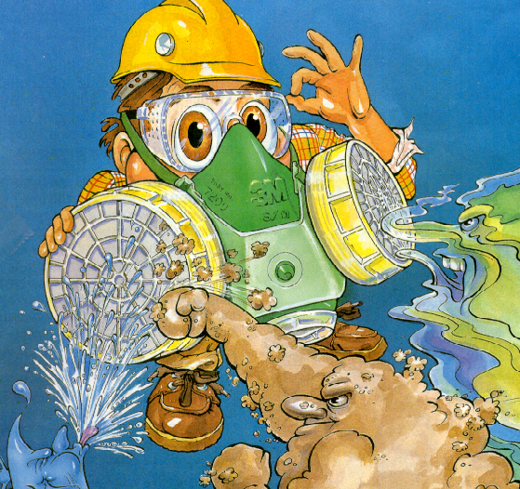
TOXIC RELATED TERMS

Slide 61
Health Hazard Data
Route of entry
Absorption through skin, inhalation, ingestion
Effect of exposure/ Symptoms
Burning and redness of eyes and skin. Repeated contact leads to dermatitis, dizziness, excitation, pallor followed by flushing, weakness, headache, breathlessness, chest constriction, coma and possible death. It is a suspected human carcinogen
Emergency treatment
Flush eyes with plenty of water for atleast 10 minutes. Remove contaminated clothing. Wash affected skin with soap and water. If inhaled, remove the victim to fresh air. Give artificial respiration, if breathing has stopped. If ingested, have victim, drink water or milk. Do not induce vomiting.. Obtain medical attention immediately.
Permissible Exposure Limit
TLV-TWA ( ACGIH)
10 ppm,
32 mg/m³
STEL(ACGIH)
DNA
LD 50 orl-rat: 3400 mg/kg
TCLo ihl-hmn: 210 ppm
IDLH
2000 ppm
Odour threshold
5 ppm
NFPA Hazard Signals
Health
2
Flammability
3
Reactivity
0
Special
--

Slide 62

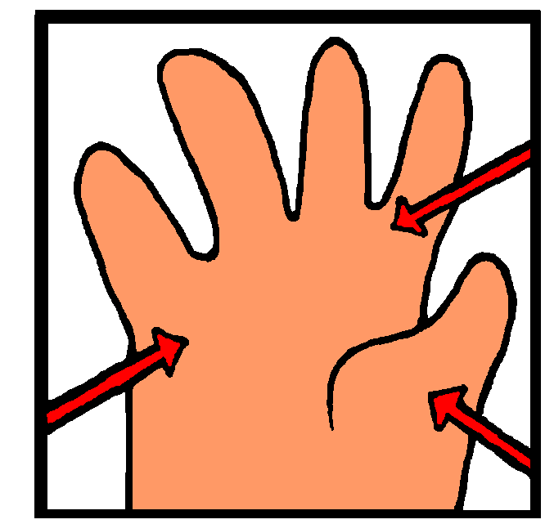
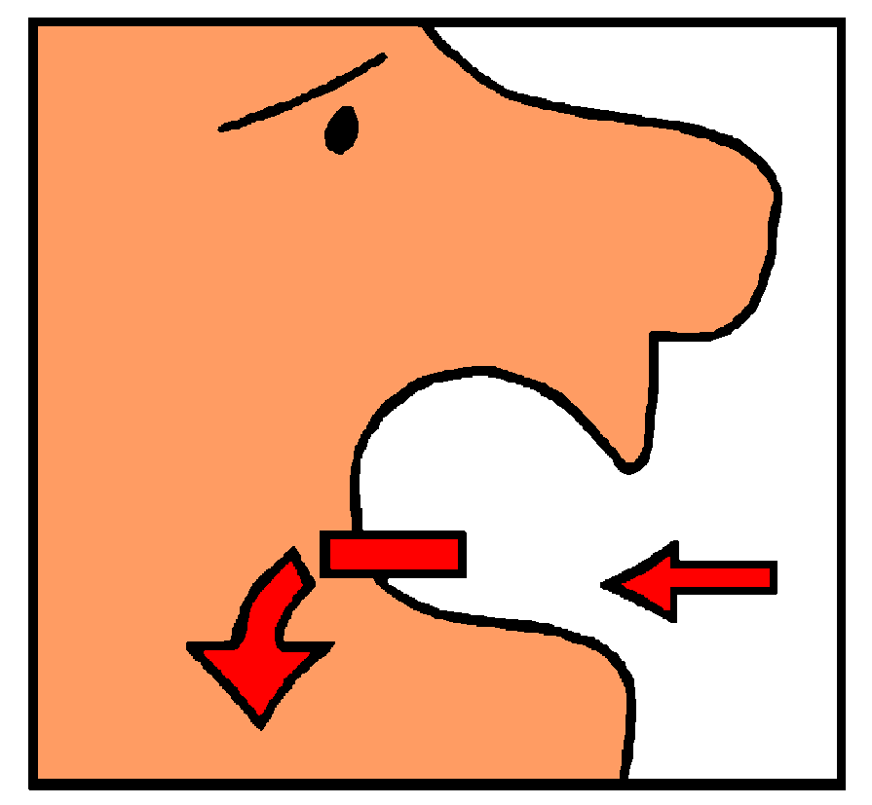
Routes of Occupational Exposure
Inhalation - nearly all materials that are airborne can be inhaled
Skin Absorption - skin contact with a substance can result in four possible actions
Ingestion - most workers do not deliberately swallow materials they handle
Injection - associated with bloodborne pathogens
Ocular - absorbed through the eyes
Notes:
NEED: Inhalation - info and particle sizes of dusts, fumes, mists, and airborne hazards at KOPPERS
Skin absorption - What are “four possible actions?
_____________________________
_____________________________ LIESA
_____________________________
_____________________________
In the “Right to Know “ slide we mentioned the standard requirements for the employees’ knowledge about the regulation. This next section of slides begins the “assessing chemical hazards” part of those requirements
After introducing the regulations, now explain that chemicals can be hazardous and the ways chemicals can be hazardous

Slide 63
Definitions
8 Hour Time Weighted Average (TWA)
Permissible Exposure Limit (PEL)
Threshold Limit Value (TLV)
Short Term Exposure Limit (STEL)
Ceiling Limit (C)
Notes:
Several definitions are needed before we go into how the industrial hygiene process identifies personnel at risk of exposure to work-place hazards, thus defining the populations that to be enrolled in OMSEP.

Slide 64
Definitions - 8-Hour TWAs
Reflects an average exposure over a “normal” 8 hour shift
All high and low concentrations are averaged with respect to time.
Calculated as follows:
C1T1 +C2T2+C3T3...+CnTn TWA = ----------------------------------
8 C=Concentration of contaminant; T= Incremental exposure time
Notes:
The eight hour Time weighted average is the “gold standard” for exposure assessment. Most consensus and regulatory exposure limits are based on this type of measurement.
An example:
A worker is exposed to chemical A at concentration of 100 mg/m³ for 3 hours of his shift. He takes an hour lunch (assume a 0 mg/cm³ concentration), works two hours in which the concentration is only 50 mg/m³, has an hour break (again assume a 0 concentration), and finishes his shift with an hour at 80 mg/m3. The TWA would be:
(100)(3)+(0)(1)+(2)(50)+(0)(1)+(80)(1) 480
TWA = --------------------------------------------------- = ----------- = 60 mg/m³
8 8

Slide 65
Definitions - PEL
OSHA sets permissible exposure limits (PEL’s) to protect workers against the health effects of exposure to hazardous substances. OSHA PEL’s are based on an 8-hour time weighted average (TWA) exposure.
PEL’s are regulatory limits on the amount or concentration of a substance in the air.
Notes:
The PEL’s are established by OSHA and are legal exposure limits. Unfortunately, they are extremely difficult to update and many do not reflect the most recent toxicological data.

Slide 66
Definitions - TLV
Threshold Limit Values (TLVs®) represent conditions under which it is believed that nearly all workers may be repeatedly exposed day after day without adverse health effects
TLV’s are intended for use as guidelines or recommendations in the control of potential workplace health hazards; they are not enforceable by law
Notes:
TLV’s are set by the American Conference of Governmental Industrial Hygienists (ACGIH). They include chemicals and physical stressors such as noise. They are not regulatory but are updated frequently to reflect updates in scientific evidence.

Slide 67
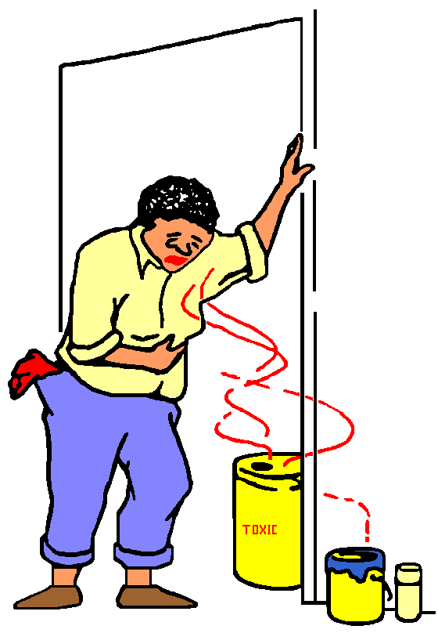
Definitions - STEL’s & Ceilings
STEL: 15-minute average exposures which should not be exceeded at any time during a workday even if the 8-hour TWA is within acceptable levels.
Ceilings: Concentrations that should not be exceeded during any part of the workday--not even for an instant.
Notes:
The short term exposure limit and ceiling limit are used for chemicals in which a short exposure is known to cause adverse human health effects. PEL’s are only expressed as TWA’s.

Slide 68
Lethal Dose or Lethal Concentration
Toxicological data is frequently reported in terms of lethal dose or lethal concentration.
An LD₅₀ is the amount of material expected to kill one-half of a group of test animals. When the test compound is a gas, results are reported as an LC₅₀.

Slide 69
LD₅₀ values are reported in milligrams toxin administered to the test animal per kilogram of body weight. A lower LD₅₀ value means that it takes less material to induce a toxic effect, that is, the toxin is potentially more harmful.
LC₅₀ values are reported in milligrams toxin per cubic meter of air (mg/m³) or in parts per million (ppm). As with LD₅₀ values, a lower LC₅₀ means that the material has a higher toxicity.

Slide 70


The following three slides provide information intended to assist in developing a sense of the potential harm of a chemical agent given a particular toxicity rating.

Slide 71
Acute Toxicity Hazard Levels
Toxicity
Rating
Oral LD₅₀
(Rats, per kg)
Skin contact LD₅₀
(Rabbits, per kg)
Inhalation LC₅₀ (Rats, ppm, 1 hr)
Inhalation LC₅₀ (Rats, mg/m³, 1 hr)
high
<50mg
<200mg
<200
<2,000
medium
50-500mg
200-1,000mg
200-2,000
2,000-20,000
low
500-5,000mg
1-5g
2,000-20,000
20,000-200,000
Source: Prudent Practices in the Laboratory, 1995

Slide 72
Probable Lethal Dose for Humans
Toxicity
Rating
Animal LD₅₀
(per kg)
Lethal Dose When Ingested by 70-kg (150lb) Human
extremely toxic
<5mg
less than 7 drops
highly toxic
5-50mg
7 drops to 1 teaspoonful
moderately toxic
50-500mg
1 teaspoonful to 1 ounce
slightly toxic
500-5,000mg
1 ounce to 1 pint
practically nontoxic
above 5,000mg
above 1 pint
Source: Prudent Practices in the Laboratory, 1995

Slide 73
Lethal dose and lethal concentration examples
Compound
Animal
Route
LD₅₀/LC₅₀
Ethanol
Rat
Inhalation
20,000ppm
Ascorbic Acid*
Rat
Oral
11,900mg/kg
Acetone  
Rat
Oral
5,800mg/kg
Acetic Acid 
Rat
Oral
3,310mg/kg
Aspirin
Rat
Injection
1,450mg/kg
Formaldehyde
Rat
Oral
800mg/kg
Atrazine (herbicide)
Rat
Oral
672mg/kg
Phenol
Rat
Oral
317mg/kg
* a.k.a. Vitamin C
 Constituent of vinegar
  Constituent of nail polish remover

Slide 74
Carcinogen, Mutagens, Teratogens
Carcinogen means “Cancer Causing”. Known Human Carcinogens , Suspect Carcinogens
Mutagens : Chemicals or forms of radiation that causes changes in the genetic structure of living cells. Reproductive cells Hemophilia, Mongolism), Body Cells (Cancer)
Teratogens Means “monster making”. An agent that may cause physical defects in the developing embryo or fetus when a pregnant female is exposed, without harming the mother Examples include: alidomide, Ethanol, Ethylene Glycol

Slide 75
NFPA Diamond
The National Fire Protection Association (NFPA) has developed a simple and effective hazard rating system.
Blue represents the health hazard of a material,
Red is for flammability, and
reactivity is represented by yellow.
The numbers 0 through 4 represent the hazard level within each category, with 4 being the most hazardous.
3
1
0
W

Slide 76
NFPA Flammability / Health Hazard Codes
4 Materials that will rapidly or completely vaporize at atmospheric pressure and normal ambient temperature, or that are readily dispersed in air and that will burn readily. Liquids with a flashpoint below 73ºF and a boiling point below 100ºF.
3 Liquids and solid that can be ignited under almost all ambient temperature conditions. Liquids with a flashpoint below 73ºF and a boiling point above 100ºF or liquids with a flashpoint above 73ºF but not exceeding 100ºF and a boiling point below 100ºF.
2 Materials that must be moderately heated or exposed to relatively high ambient temperatures before ignition can occur. Liquids with flashpoint above 100ºF but not exceeding 200ºF.
1 Materials that must be preheated before ignition can occur. Liquids that have a flashpoint above 200ºF.
0 Materials that will not burn.
4 Materials that on very short exposure could cause death or major residual injury.
3 Materials that on short exposure could cause serious temporary or residual injury.
2 Materials that on intense or continued, but not chronic exposure could cause incapacitation or possible residual injury.
1 Materials that on exposure would cause irritation but only minor residual injury.
0 Materials that on exposure under fire conditions would offer no hazard beyond that of ordinary combustible material.

Slide 77
NFPA Reactivity Codes
4 Materials that in themselves are readily capable of detonation or of explosive decomposition or reaction at normal temperatures and pressures.
3 Materials that in themselves are capable of detonation or explosive decomposition or reaction but require a strong initiating source or which must be heated under confinement before initiation or which react explosively with water.
2 Materials that readily undergo violent chemical change at elevated temperatures and pressures or which react violently with water or which may form explosive mixtures with water.
1 Materials that in themselves are normally stable, but which can become unstable at elevated temperatures and pressures.
0 Materials that in themselves are normally stable, even under fire exposure conditions, and which are not reactive with water.

Slide 78
NFPA Special Hazard Codes
OX - oxidizer
ACID - acid
ALK - alkali
CORR - corrosive
W - use no water
- radioactive
Notes:
HMIS - like NFPA (PPE codes added)

Slide 79
Preventive Measures
PERSONAL PROTECTIVE MATERIAL
Use PVC of rubber gloves and apron, gum boots, goggles / face shield and overalls. Use breathing apparatus if required
HANDLING AND STORAGE PRECAUTIONS
Store in a cool, clean, ventilated, fireproof storage area. keep away from heat, sparks, open flame and incompatible materials(strong oxidising agents). Protect containers against physical damage.

Slide 80
Emergency and First Aid Measures
FIRE ( Class of fire : B )
Fire extinguish media
Alcohol resistant foam or Dry agent (CO₂, dry chemical powder)
Special Procedures
None
Unusual Hazards
None
EXPOSURE
First Aid Measures
Eye : Flush eyes with plenty of water for atleast 10 minutes. Skin : Remove contaminated clothing and wash affected skin with soap and water. Inhalation : Remove victim to fresh air. If not breathing, give artificial respiration. Ingestion : if conscious, have victim drink water or milk. Do not induce vomiting. In all cases obtain medical attention immediately.
Antidotes/ Dosages
DNA

Slide 81


Class A Fires
Are fires fueled by materials that, when they burn, leave a residue in the form of ash
Paper, wood, cloth, rubber, and certain plastics
Extinguisher type: Water, Dry Chemical (MAP)

Slide 82


Class B Fires
Fires which involve flammable liquids
Gasoline, paint thinner, grease, propane, acetylene
Extinguisher type: Carbon Dioxide, Dry Chemical, Foam

Slide 83


Class C Fires
Flammable Gases
Extinguisher type: Carbon Dioxide, Dry Chemical

Slide 84

Class D Fires
Class D fires involve exotic metals, such as magnesium, sodium, titanium, and certain organometallic compounds such as alkyllithium and Grignard reagents
Extinguisher Type : DCP 9 Special type – Ternary eutectic chloride)

Slide 85
Additional Information
ECOLOGICAL INFORMATION
Ecotoxicity
Harmful to aquatic life in very low concentrations. Aquatic toxicity : 5 ppm/6 h/minnow/ lethal/ distilled water : 20 ppm/24h/sunfish TLm/tap water
Persistence
Calculated half time in water at 25 º C and 1m depth ( based on evaporation rate of 0.144 m/h) = 4.81h
OTHER INFORMATION
BEI (total phenol in urine at end of shift) not to exceed 50 mg/l mean value
References ( FOR OBTAINING MORE INFORMATION)
1. Hazardous Cemicals Data Book: G Weiss: Noyes Data Corp USA
2. Hand Book of Environment Data: Karen Verschueren : Van Nostrand Reinhold Co., USA

Slide 86
Keeping it Safe
Corrosives, solvents, and other chemical substances can be potentially dangerous
Safe handling procedures
read container labels
check Material Safety Data Sheets
Never sniff a chemical for identification
Use appropriate personal protective equipment
Notes:
Speaker’s introduction to slide:
“Now that we know what to look for in the way of Hazard Awareness, let’s look at how to practice Hazard Avoidance. Here’s a small list of “rules” of keeping on the safe side of Hazard Communication and Chemical Safety.”
[Add KOPPERS information here regarding examples of specific corrosives, solvents, and other chemical substances.]

Slide 87
Reading Chemical Labels
Warning labels provide important information about the chemical
“Danger”
“Warning”
“ Caution”
Always read the label before you
begin a job using a potentially
hazardous chemical
Notes:
This slide covers what to look for in a chemical label.
Here, the instructor can explain how reading labels and (or if the audience can’t read) looking for the skull and bones symbols can keep the audience members “on the safe side.”

Slide 88
Hazard Communication Plan
to develop and implement a written hazard communication program
to provide Hazard Communication training for employees
initially to all
whenever a new hazard is
introduced into the workplace
Notes:
This slide provides an explanation of what KOPPERS must do to comply with the requirements of the HazCom standard.

Slide 89
Hazard Communication Plan
The plan includes
a list of the hazardous chemicals known to
be present in your workplace
how MSDS filing requirements are being met
type of labeling system being used
detailed information on training and compliance
methods to inform you of
non-routine tasks and safe procedures
methods to inform outside
contractors of the HazCom program
Notes:
This slide provides an explanation of what KOPPERS must do to comply with the requirements of the HazCom standard (continued).

Slide 90
Special Hazards
Entering vessels, tanks, railcars, or any confined space
Prior to opening or entry
safe work permit
reduce contents to minimum possible level
Lockout / Tag out
MSDS for the materials
Initial opening
utilize plant confined work space entry program criteria
Notes:
When entering vessels, tanks, rail cars, or any equipment which is considered a confined space, there are required actions.
Prior to opening or entry.
1. Notify the area supervisor and employees working in the area of the intended actions and obtain a Safety Work permit.
2. Have the contents reduced to the minimum possible level.
3. Secure the space by the use of the Plant Lockout/Tagout Program. This includes disconnecting any mechanical equipment, relieving any positive or negative pressure, installing blanks in flanges or breaking all lines. ZERO ENERGY STATE.
4. Review the MSDS for the materials that are normally in the vessel.
At initial opening.
1. Using the appropriate PPE open the system. Assume until established that he exposures will require the highest level of protection.
2. Sample the atmosphere in the area to be entered using the appropriate instrumentation.
3. Ventilate the work space.
4. Entry is to be made using the Plant Confined Work Space Entry program criteria for rescue, observation, and communication.
5. Upon completion of the job, advise the area personnel and supervision that the system is to be restored.

Slide 91
Special Hazards, continued
Working with unlabeled piping
Contact or member and have contents of piping verified
Seek Member assistance to remove contents or relieve any pressure
Preplan the job
Management of process spills or leaks
Secure the area
Notes:
When working with unlabeled piping. The required actions include…
1. Contact the appropriate supervision or operators in the area and have the contents on the piping in question verified.
2. Seek appropriate operator assistance to remove contents or relieve any pressure before breaking any piping.
3. Preplan he job with appropriate supervision, implementing the proper Lockout/Tagout procedures and utilizing the appropriate PPE for the potential hazards present.
For the management of process spills or leaks, the required actions include…
1. Implementing the Plant Emergency Control Program by contacting the area supervisor and operators immediately.
2. Depending on the character of the escaping material, remove potential sources of ignition, prevent others from entering the area, and assist in control and clean up as directed by the appropriate supervision after reviewing the associated hazards and obtaining the necessary PPE.

Slide 92
Any Questions
?????????
Thanks !!!!!!!!!!!!!!!!!!!!!!!!!!!
Notes:
This slide prompts the class to ask questions concerning additional information they might need.

